Slide 1
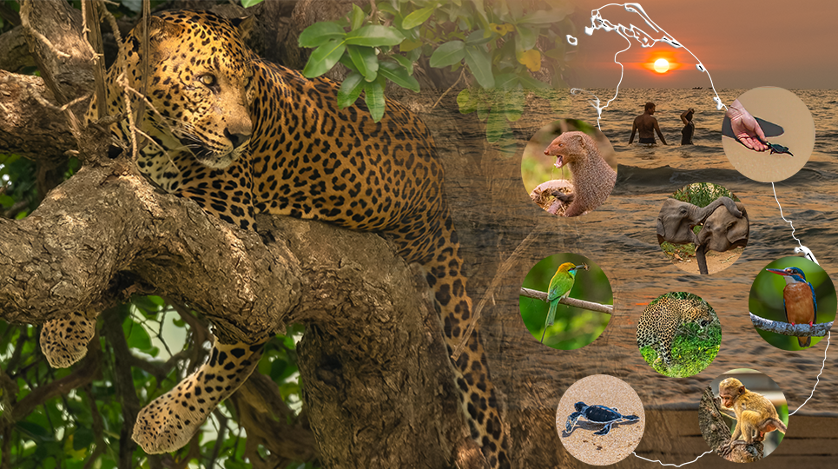
Welcome
Analysing photography holidays in Sri Lanka
Roshan & Godswill]
Data Analytics

Slide 2
Agenda
List the main areas you will cover in your project presentation.
Selecting Sri Lanka for this project.
Problem statement
Hypothesis
Data and tools used and repurposing publicly available dataset for the project.
Exploratory analysis in Sri Lankan tourisms
Photography holiday activities during their visits
Identify visited locations
Key stakeholders (e.g., tour operators, photographers, conservation organizations)

Slide 3
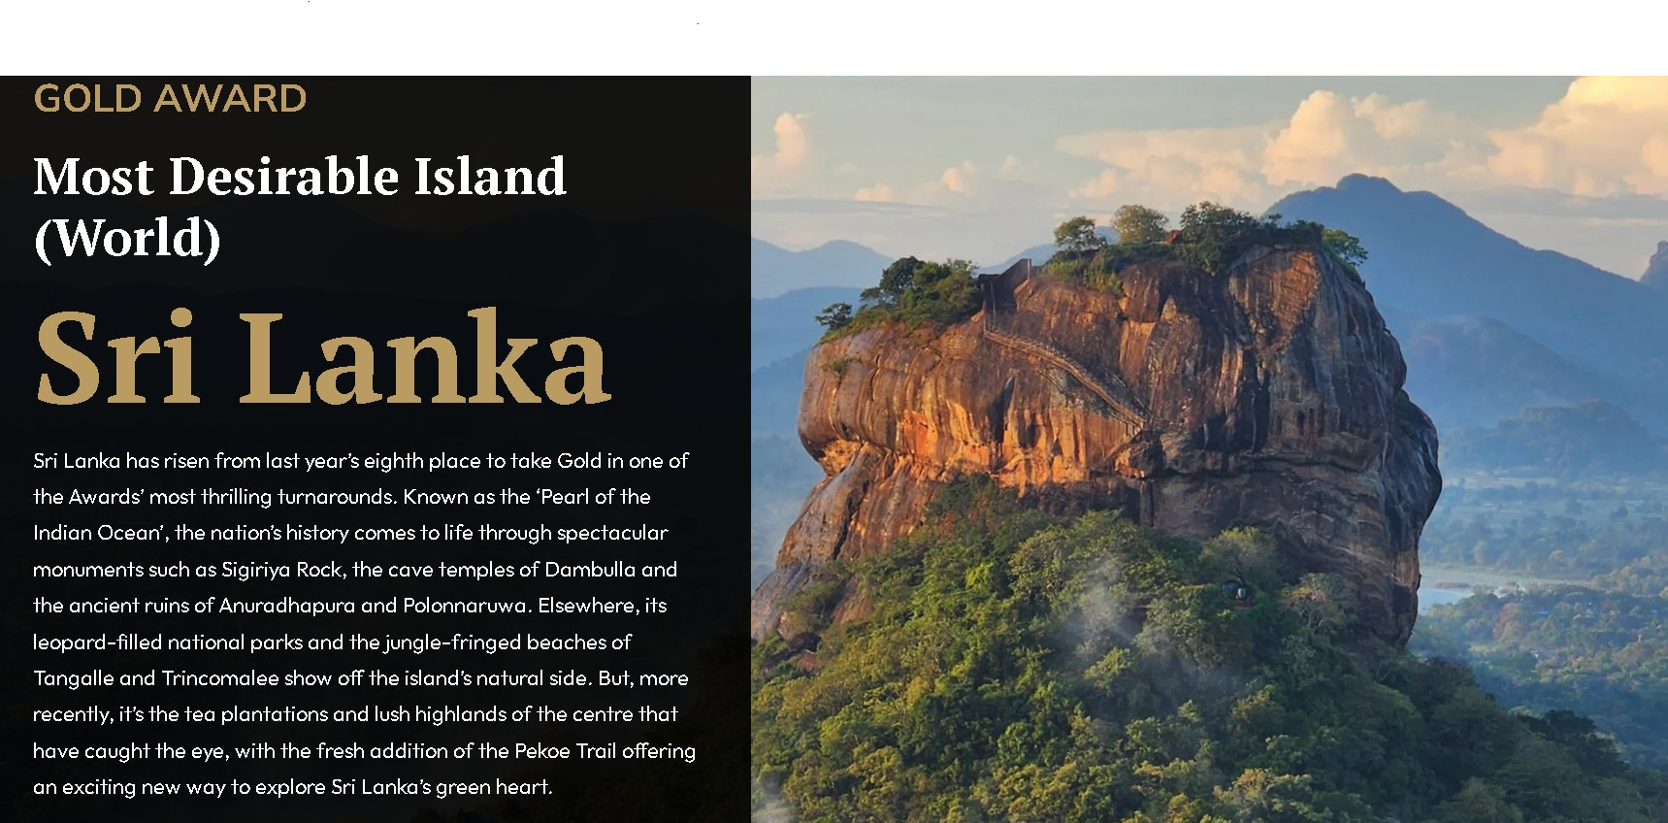
Selecting Sri Lanka for this project.
Sri Lanka won the Wanderlust Reader Gold Award for “Most Desirable Island to Visit” in 2024.
https://www.wanderlustmagazine.com/inspiration/wanderlust-travel-awards-2024-the-results

Slide 4
The Problem Statement
Is there a considerable interest in photography holidays in Sri Lanka?
To assess the demand for photography holidays in Sri Lanka, we need to examine the activities holidaymakers engage in, the destinations they favour during their travels, and to recognize the countries of frequent holidaymakers.

Slide 5
Hypothesis
There is a significant demand for photography holidays in Sri Lanka. holidaymakers who choose these holidays tend to engage in specific related activities, visit particular locations that are popular for photography, and a substantial portion of these travellers are repeat visitors.

Slide 6
Data and Tools Used
A publicly available dataset related to Tourism and Travel Review in Sri Lanka from year 2010 to 2023 used for this project .
A MySQL database was created from the source data, with individual tables established for processing and analysis using SQL and Python.
In an ideal scenario, additional data that would have been beneficial includes vacation type, the number of days spent in one location, and a list of activities participated in.
The tools I utilized for processing and statistical analysis include Excel, Python, MySQL, Tableau Desktop for data visualization, and Power BI.

Slide 7
Data and Tools Used
This project utilizes a publicly available dataset concerning Tourism and Travel Reviews in Sri Lanka, covering the years from 2010 to 2023.
To create an optimal dataset, a MySQL database was established using the source data, with separate tables set up for analysis and processing through SQL and Python.
In a perfect scenario, it would have been useful to include additional information such as the type of vacation, the duration of stay at each location, and a list of activities undertaken.
The tools utilized for processing and statistical analysis consisted of Excel, Python, MySQL, Tableau Desktop for data visualization, and Power BI.

Slide 8

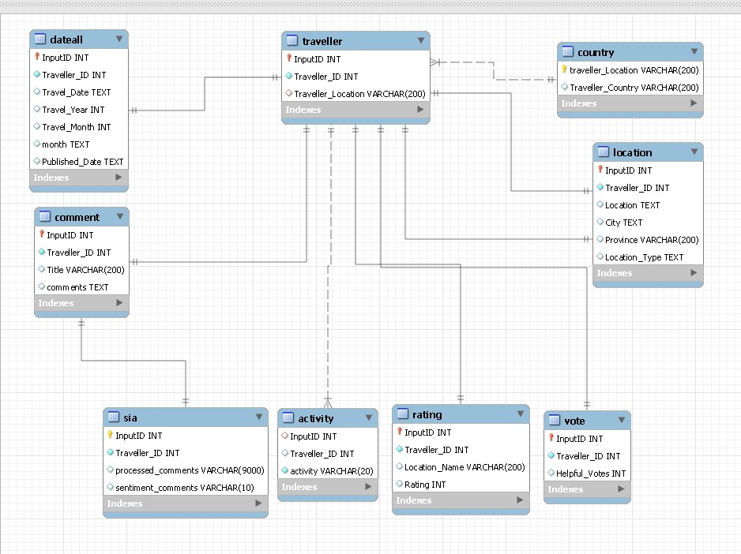



Data Processing
Configuration of a database utilizing a CSV source dataset along with the data flow for visualizations.
ETL.py
Reviews.CSV
Country Mapper
Data extraction.py
for QC
Sentiment analysis.py

Slide 9
Data Processing (Continued)
Country table
Identifying and addressing missing or unclear country names by linking them to the data points associated with city name entries.

Slide 10
Data Processing (Continued)
Sentiment comments(SIA) table

Slide 11
Data Processing (Continued)
Distinguishing between photography visits and non-photography visits by setting a variable, such as “Photography.”

Slide 12
Data Processing (Continued)
Activity table
Programmatical read travelers comments from dataset column and creating a new variable “activity” allocating activities during their holiday visit .

Slide 13
Data Processing (Continued)

Slide 14
Data Processing
Were there any surprising insights from your data processing/exploration?
Plots showing these insights? These can be visuals exported from Tableau.

Slide 15
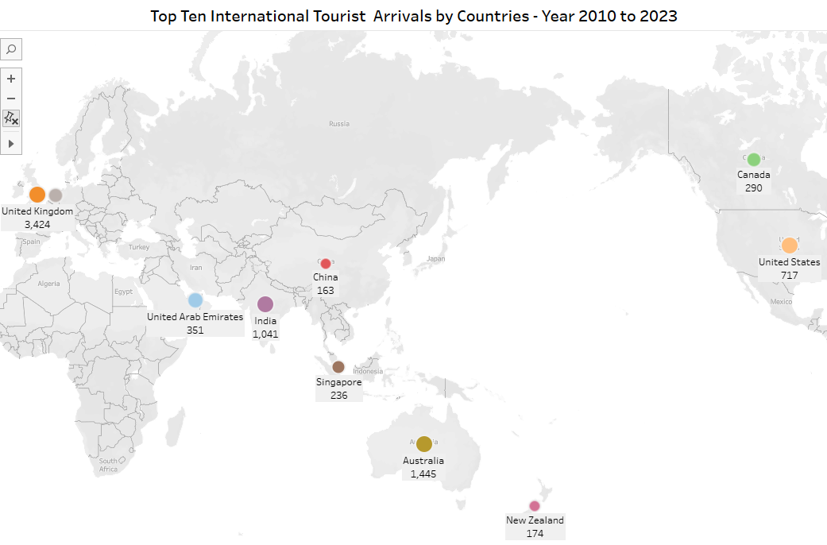
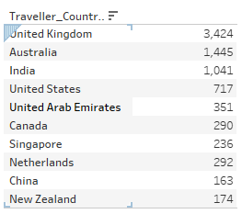
Statistical Analysis

Slide 16
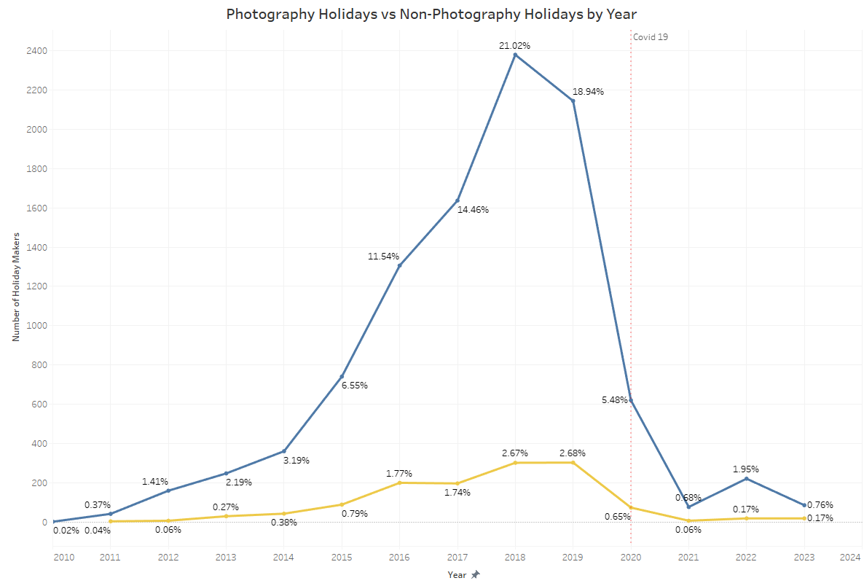
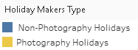
Statistical Analysis

Slide 17
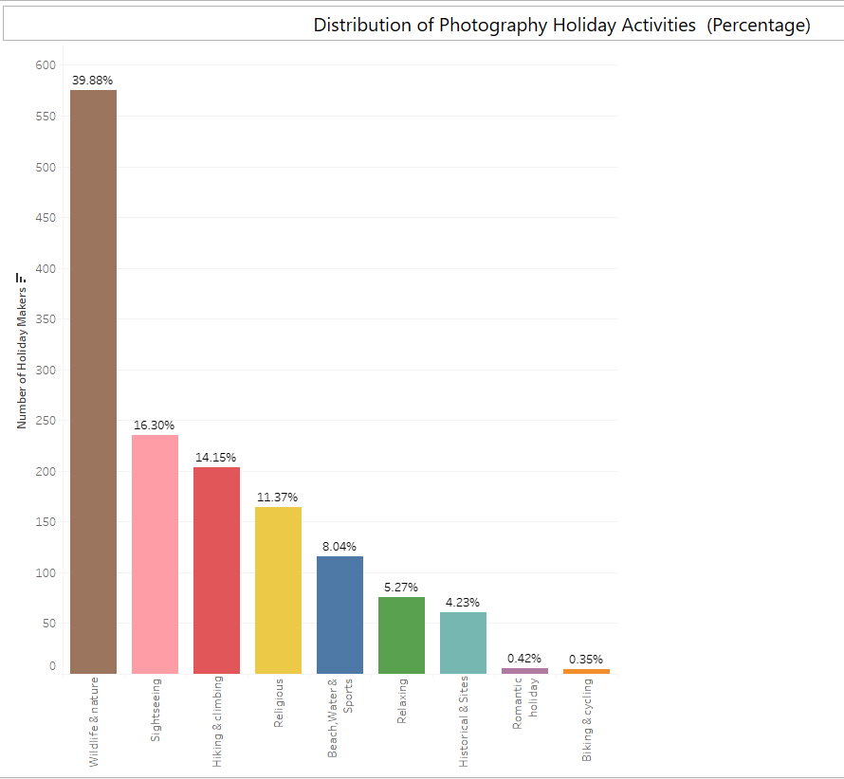
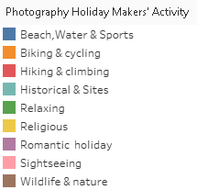
Statistical Analysis

Slide 18
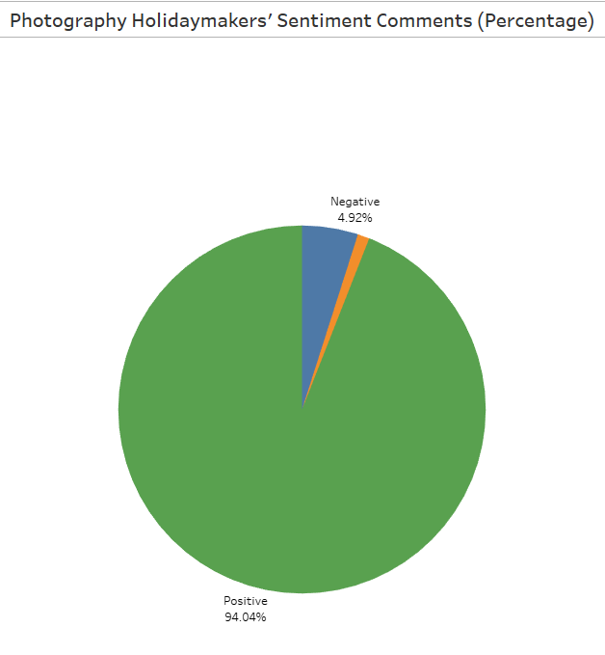
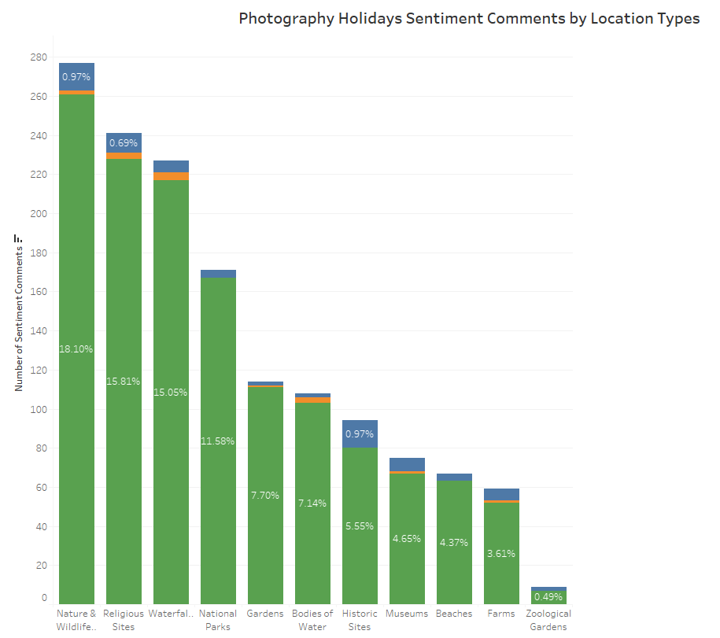
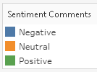
Statistical Analysis

Slide 19
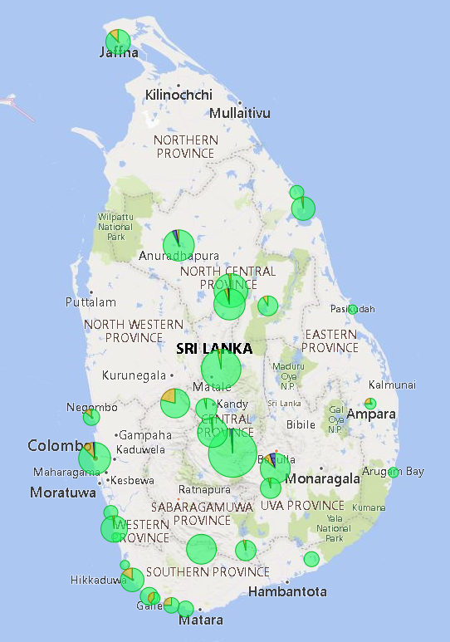
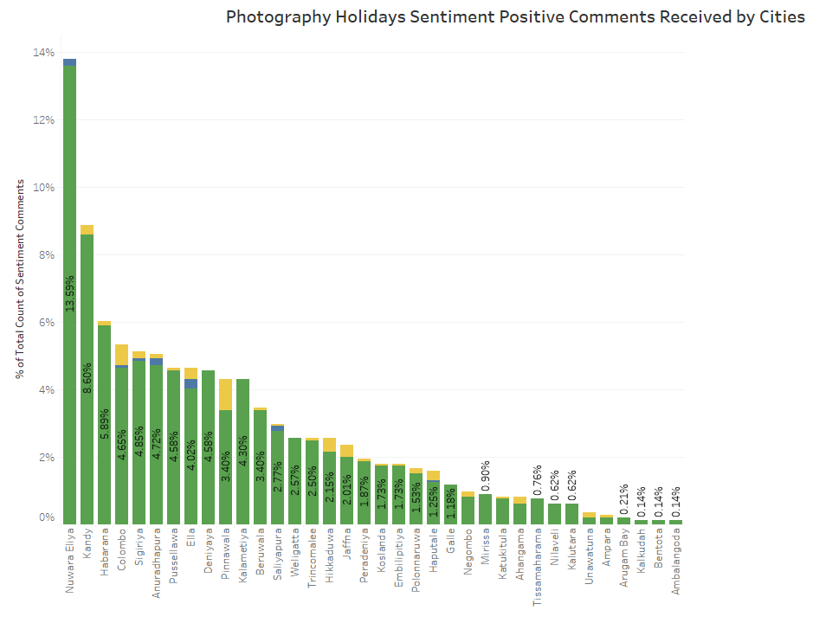
Statistical Analysis

Slide 20
Statistical Analysis

Slide 21
Statistical Analysis
An overview of the different statistical analyses performed, and why they were chosen.
Note: Feel free to make multiple slides to discuss each one in more detail.

Slide 22
Insights Discussion
What were the main insights from the Statistical Analyses
Note: Using visuals to discuss these would be ideal. These can be visuals exported from Tableau

Slide 23
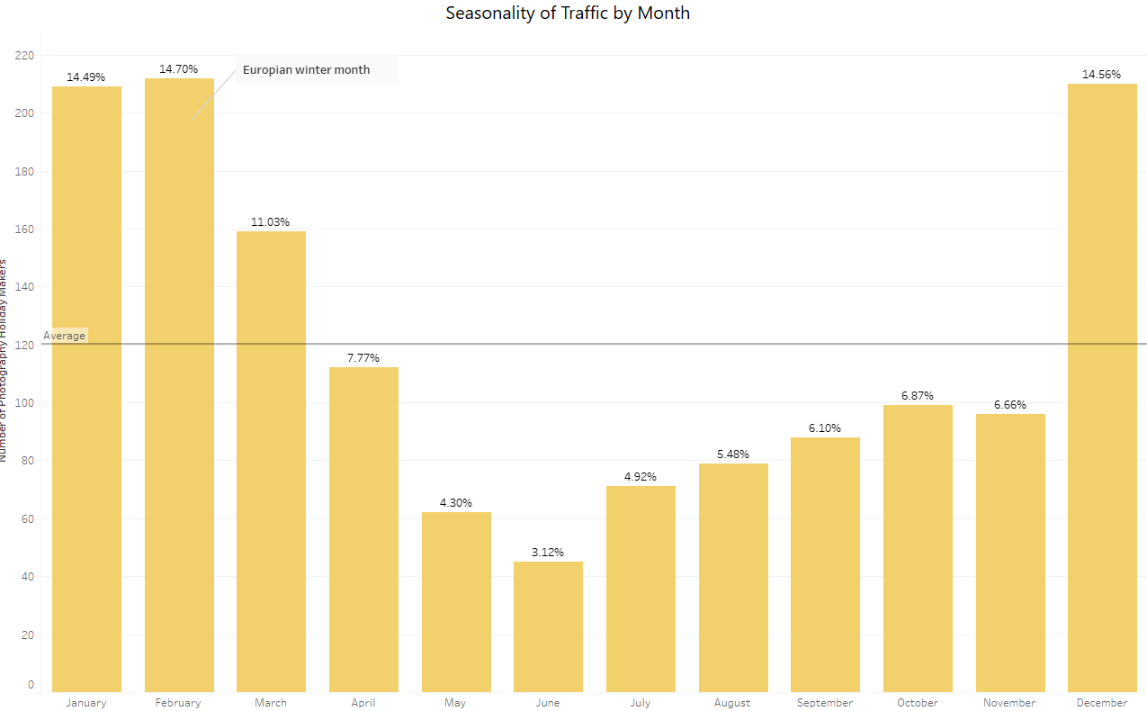
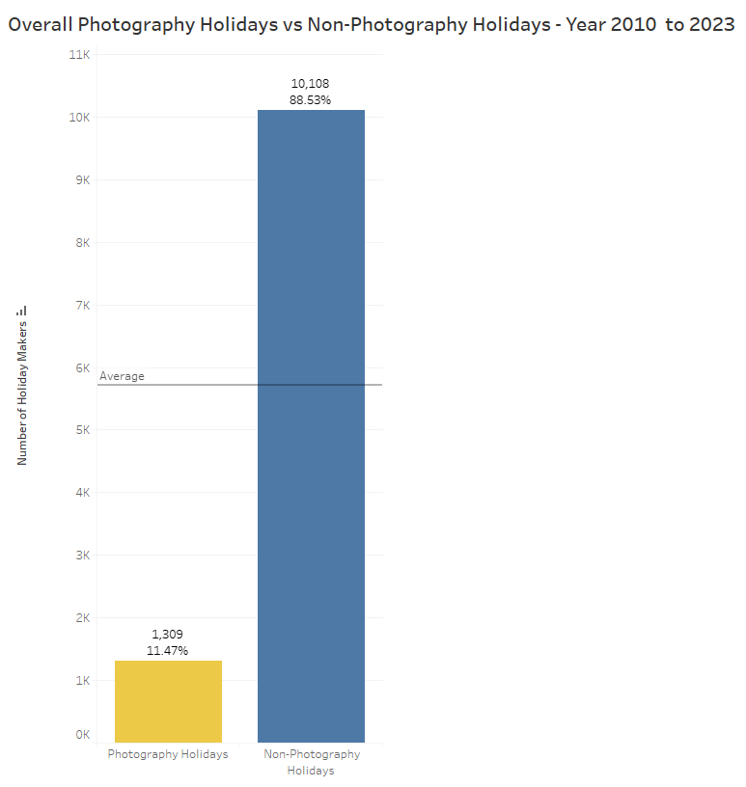
Insights Discussion

Slide 24
Summary Conclusions
Expected Hypothesis can be
Did the problem get solved from your analysis?
If not, then where do you think the issue happened.

Slide 25
Key Learnings
What would you change in this project process if you could do this all over again?

Slide 26
Thank You

Slide 27
Appendix

Slide 28
References
References for the entire workflow can go here or in Speaker Notes per slide.

